Slide 1
Filtering Scalar Field Contouring

Slide 2
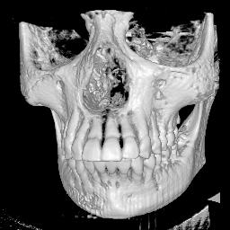
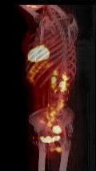
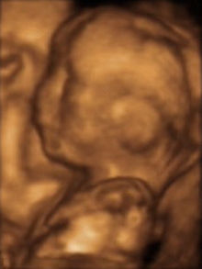
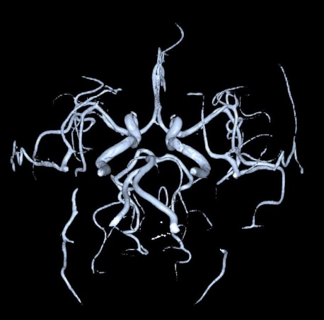
Volumetric Data in Medical Imaging
Volumetric Data = Three-dimensional domain
Computed Tomography
Magnetic Resonance Angiography
Positron Emission Tomography
3D Ultrasound

Slide 3
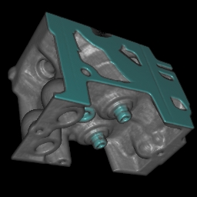
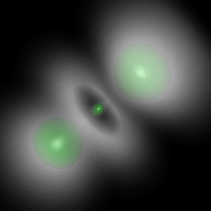
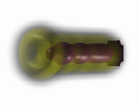
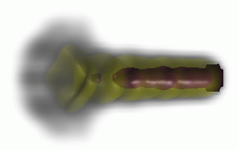
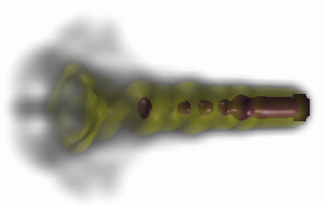
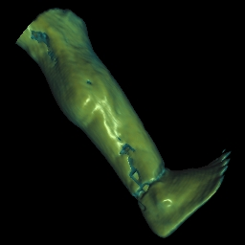
Volumetric Data in Science/Engineering
Industrial CT
Numerical Simulation: Hydrogen Atom
Numerical Simulation: Fuel injection
Scientific CT
3

Slide 4
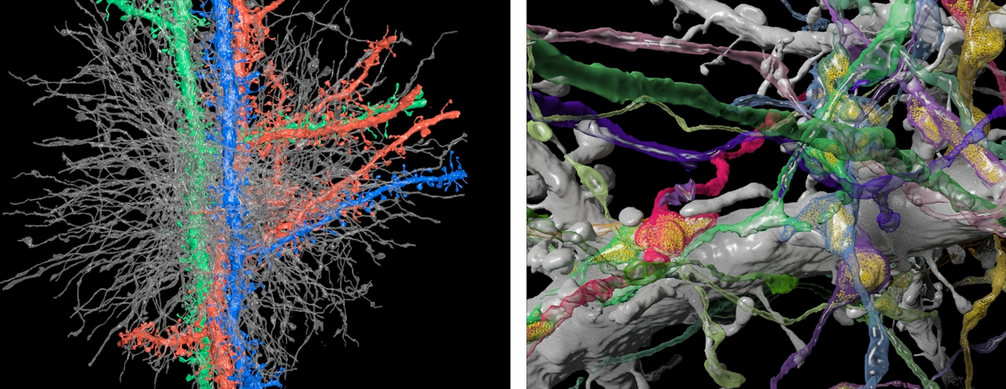
Trend: Large-Scale Volumetric Data
Biological Applications, e.g., Ultra-Thin Serial Section Electron Microscopy 1mm³ of brain tissue amounts to 20,000 slices à 40 gigapixel, total of 800 TB of image data
Image Source: Pfister et al., Visualization in Connectomics, arXiv 2012
4

Slide 5
The Visualization Pipeline
simulation
data bases
sensors
data acquisition
raw data
filtering
vis data
The Visualization Pipeline
mapping
renderable representation
rendering
images, video
interaction

Slide 6
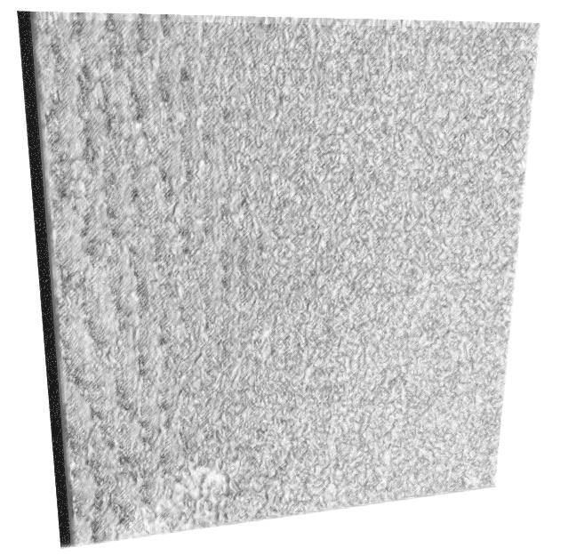
Too much data!
Notes:
Motivation for ”Data filtering“

Slide 7
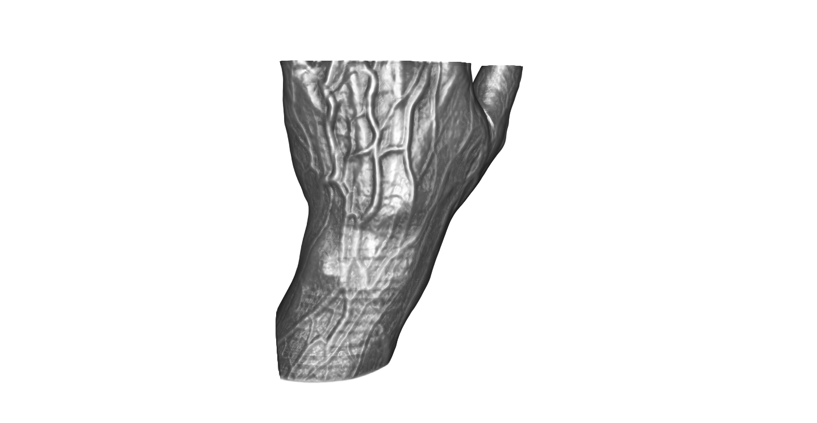
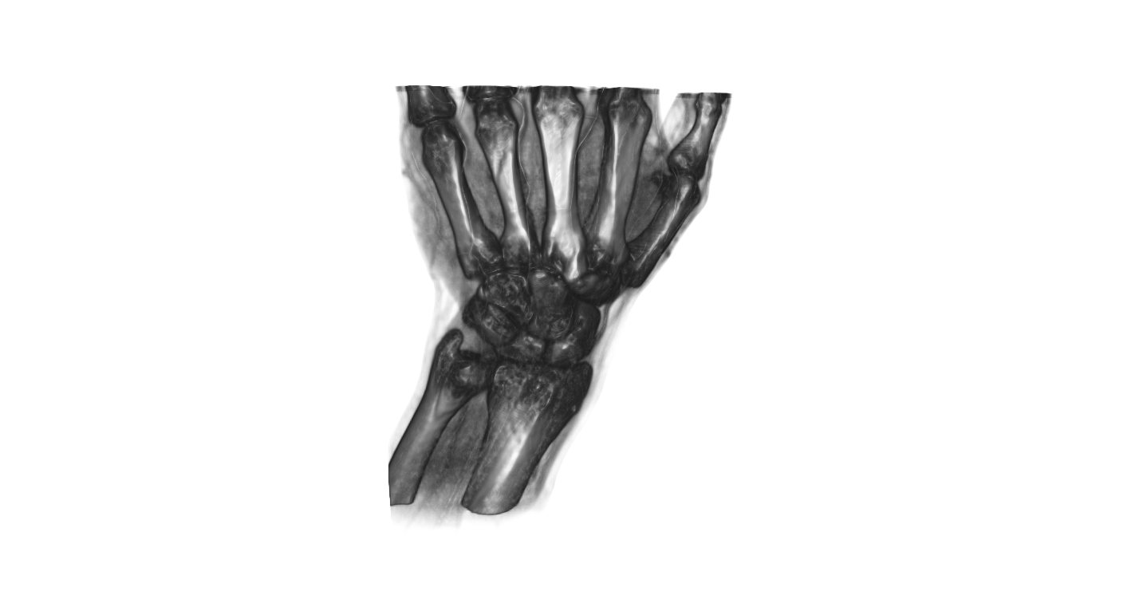
”Reduce displayed information by filtering“

Slide 8
Filtering
Filtering: ”Reduce displayed information“
Selection
Projection

Slide 9
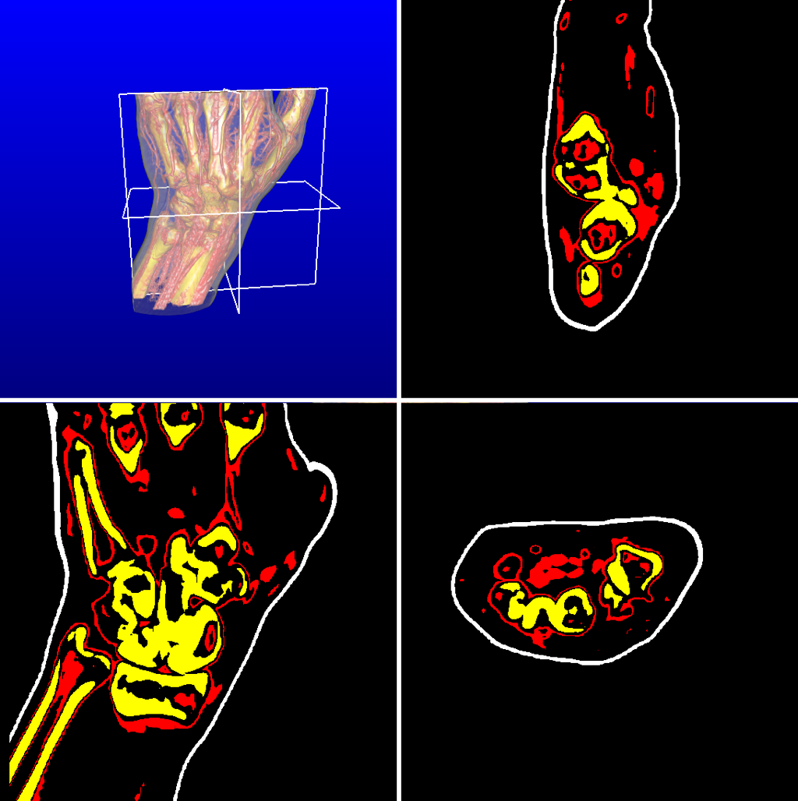
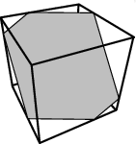
Selection: Slicing
Slicing
Example: 2D cutting surface (slice) through a 3D volume

Slide 10
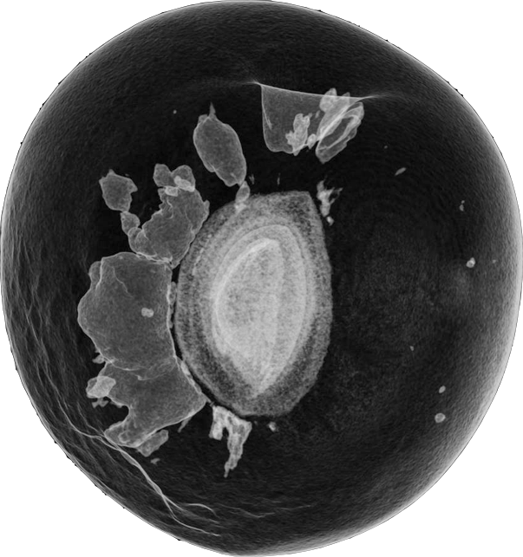

Slide 11
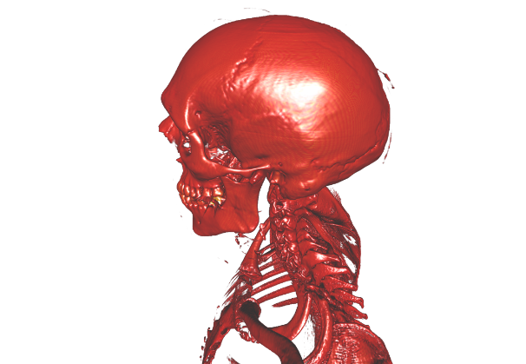
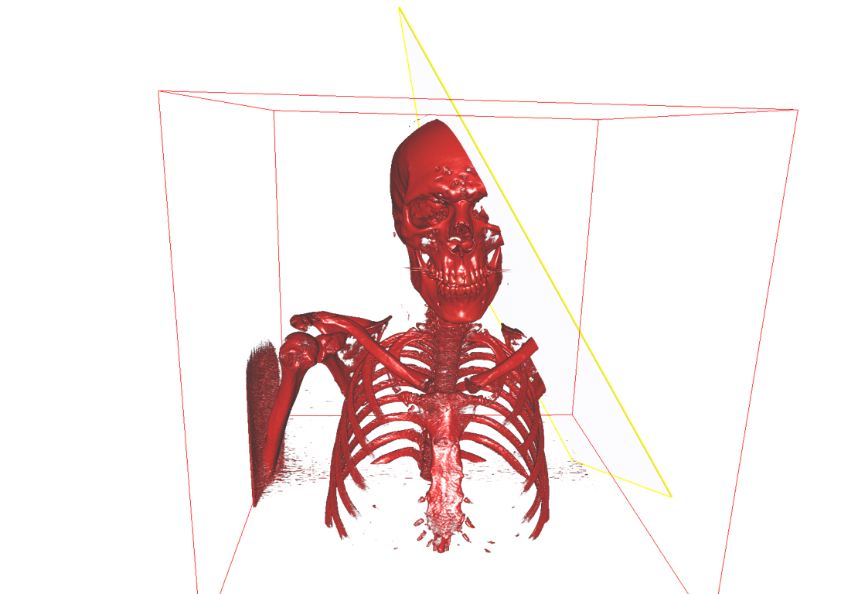
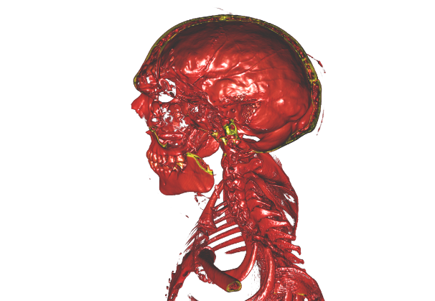
Selection: Clipping
Clipping

Slide 12
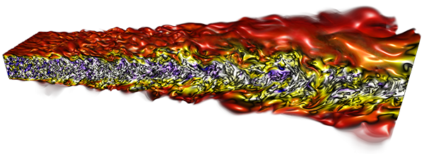

Slide 13
Selection σ
Selection σ of data according to logical conditions (predicates)
Example:
2D height field: (x,y,h)
σ = { (x,y,h) | (x^2+y^2 < 5km) ∧ (h > 1km) }
Notes:
Let the students explain this selection.

Slide 14
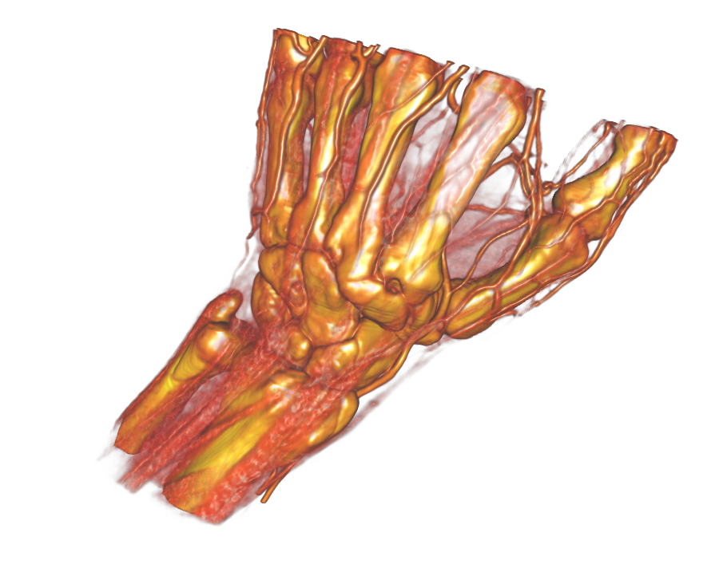
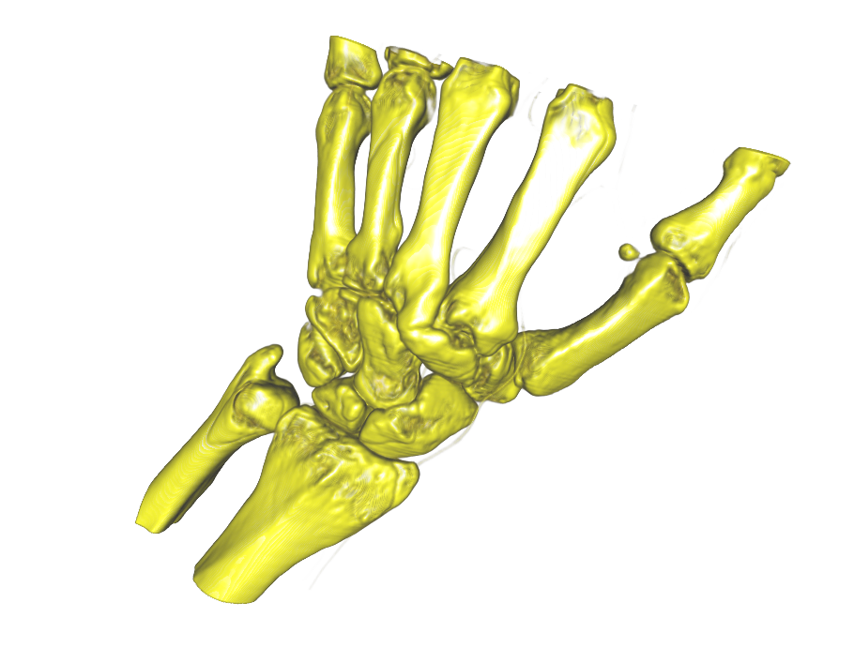
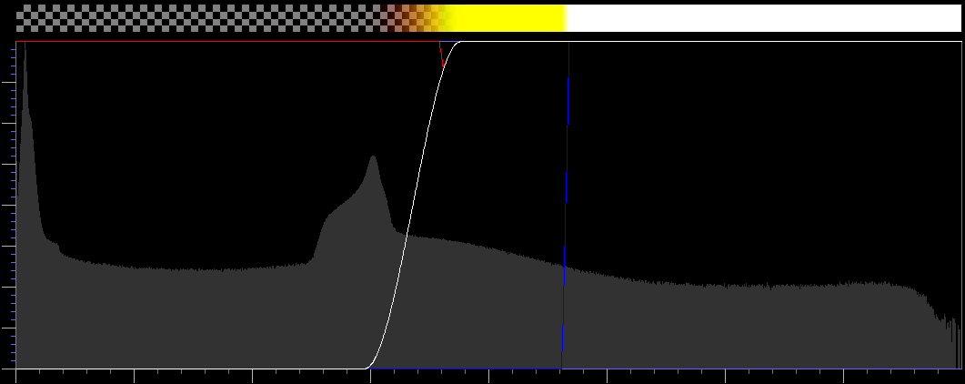
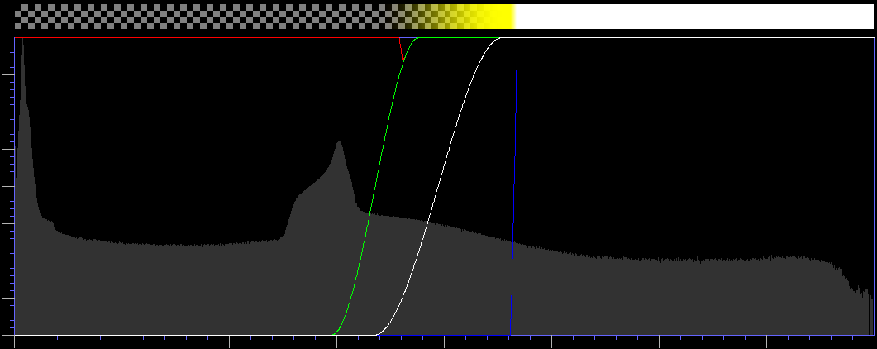
Selection: Transfer Function
Selection by Transfer Function
Remove a certain range of data values

Slide 15
Projection
Projection
Functional description for both the
Domain
Data values
Projection into subspaces or derived spaces
Smoother Functions
Function Derivatives
Notes:
Often a mapping to a subset of the original values is chosen

Slide 16
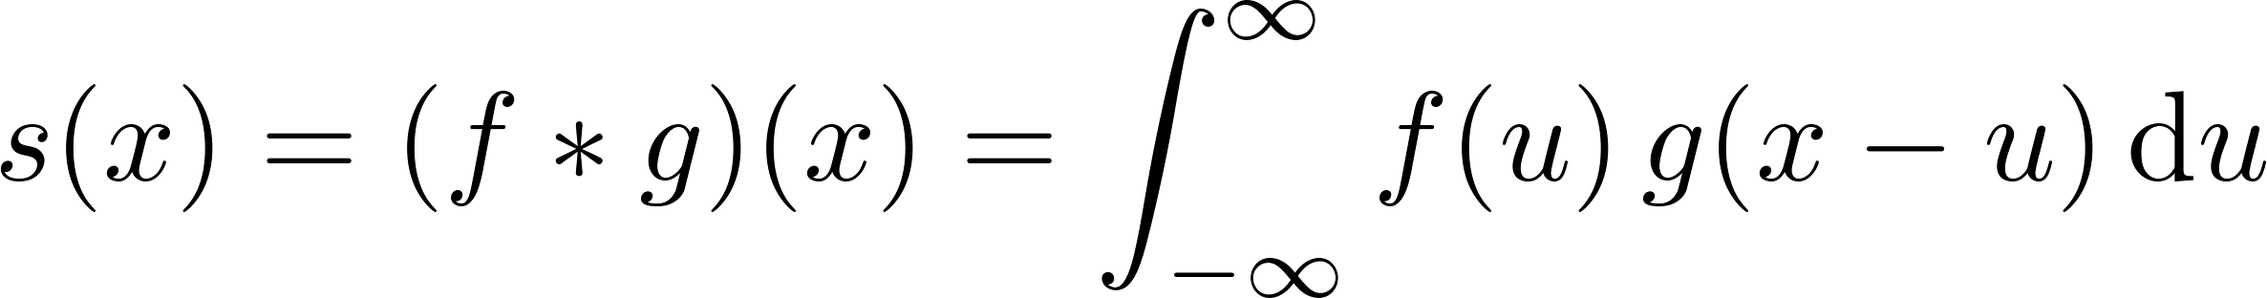
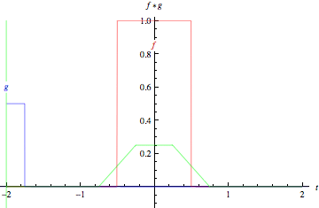
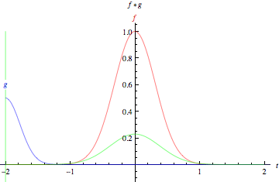
Filtering by convolution
Filtering by Convolution
”Sliding a function g(x) along a function f(x)“
Box
Gauß
http://mathworld.wolfram.com/Convolution.html
Notes:
Signal f is averaged with a weight function g(x-x´) centers g around (x)
The animations above graphically illustrate the convolution of two boxcar functions (left) and two Gaussians (right). In the plots, the green curve shows the convolution of the blue and red curves as a function of , the position indicated by the vertical green line. The gray region indicates the product as a function of , so its area as a function of is precisely the convolution. One feature to emphasize and which is not conveyed by these illustrations (since they both exclusively involve symmetric functions) is that the function must be mirrored before lagging it across and integrating.

Slide 17
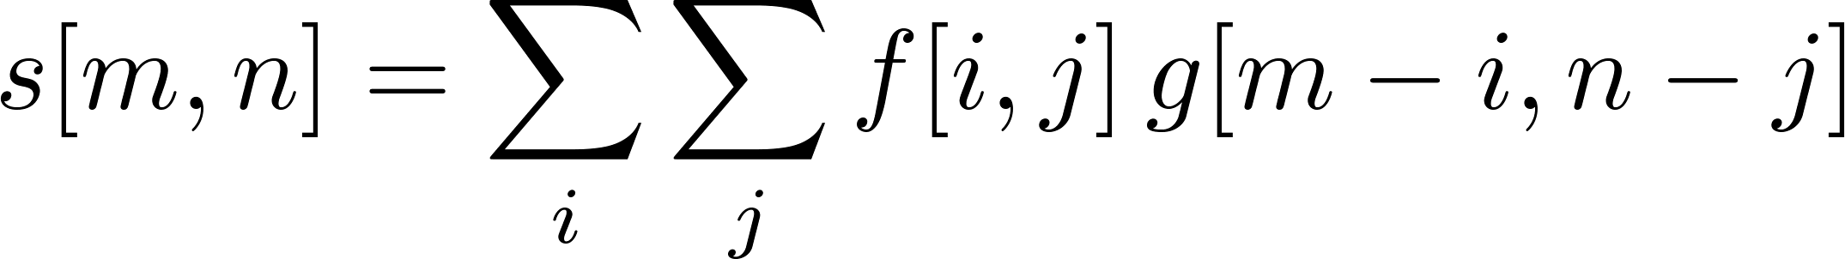
Filtering by convolution
For 2D functions f and g, their convolution is defined by:
Discrete form:

Slide 18
Convolution in image processing
Convolution in Image Processing
Filtering image f using the filter kernel g
“Sliding the kernel g over the image f“
Mainly applied to remove or enhance features
Smoothing, noise removal, edge detection ...
Typically, filter kernel is smaller than image!

Slide 19
Mean filter (averaging)
Mean Filter / Box Filter (averaging)
Reducing the intensity variation in the data
Replace each data value by the average of the neighbors
1/9
1/9
1/9
1/9
1/9
1/9
1/9
1/9
1/9

Slide 20


Original
Box-Filtered

Slide 21
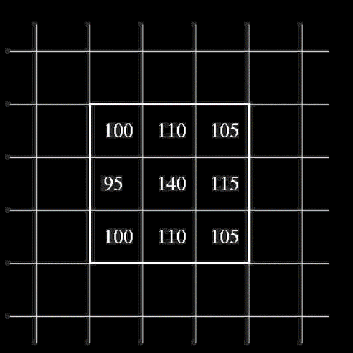
Median Filter
Median Filter (not a convolution!)
Reducing the intensity variation in the data
Replace each value by median of neighbors
More robust than mean, does not create new values
Values: 95,100,100,105,105,110,110,115,140
Median: 105

Slide 22

Original
Median-Filtered

Slide 23
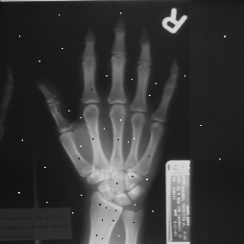
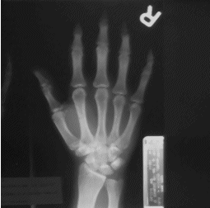
“Salt-and-Pepper Noise”
median-filtered
Notes:
Median Example: Effectively removes outliers

Slide 24
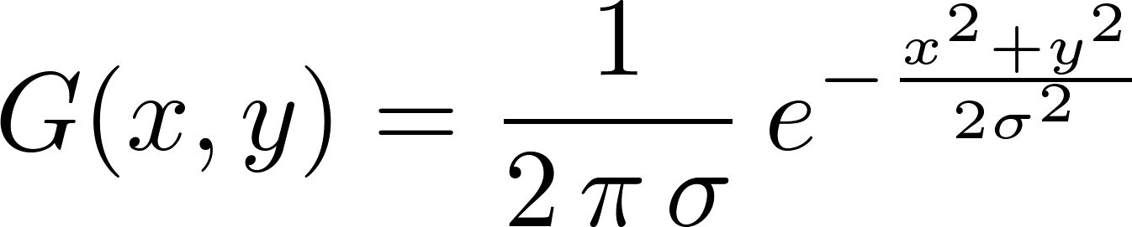
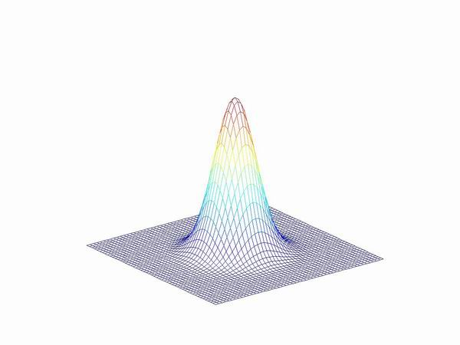
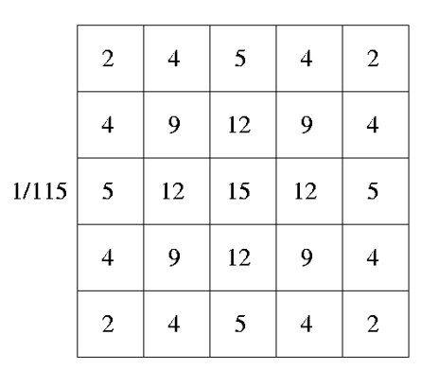
Gaussian Smoothing
Gaussian Smoothing
Gauß kernel and its discrete approximation
Notes:
Weighted average of neighbors

Slide 25

Original
Gauß-Filtered

Slide 26




Original
Box
Gauß
Median

Slide 27
Performance Consideration
2D Box & Gauß filters can be separated into two 1D filters
First: perform 1D convolution along the x-axis
Second: perform 1D convolution of intermediate result along the y-axis
Faster: Two times a 1D kernel of size 5 instead of a 2D kernel of size 25

Slide 28
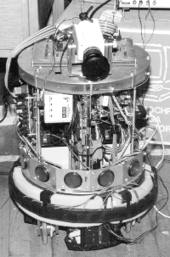
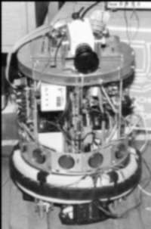
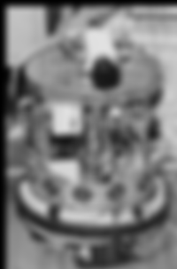
Gaussian smoothing
Original
σ=1
σ=4
Notes:
Now a couple of ”Filtering by convolution“ Examples

Slide 29
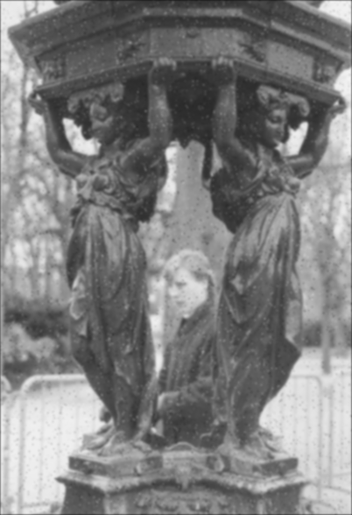


Denoising
Original
noisy
Gaussian smoothing

Slide 30
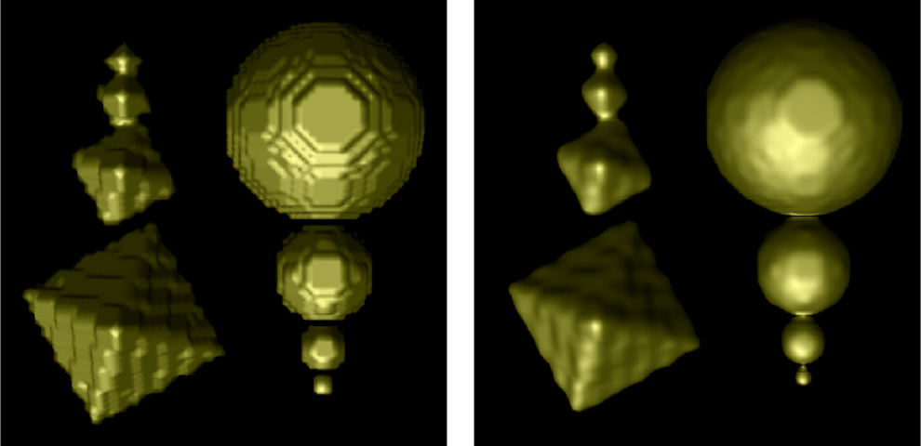
Notes:
Smoothing in 3D

Slide 31
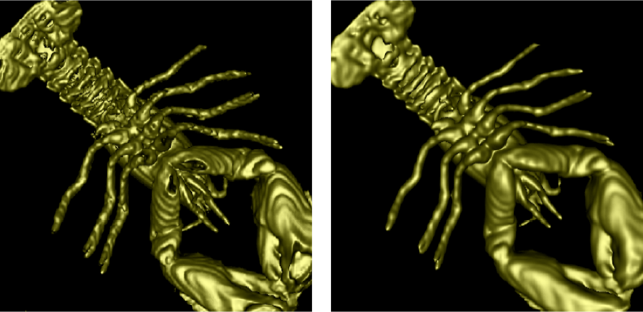

Slide 32
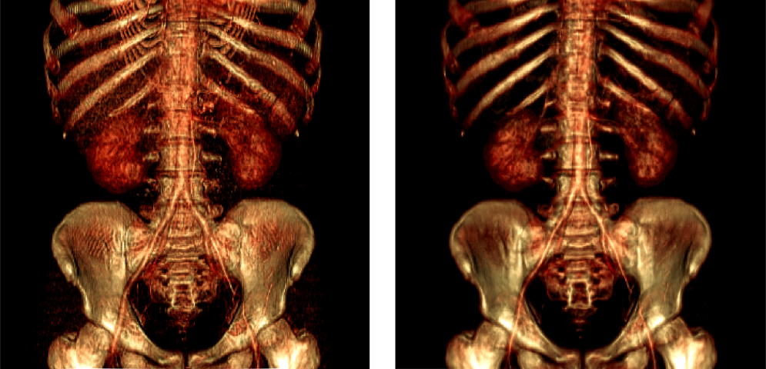
Notes:
Noise reduction in 3D

Slide 33
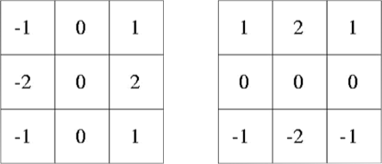
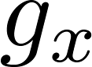

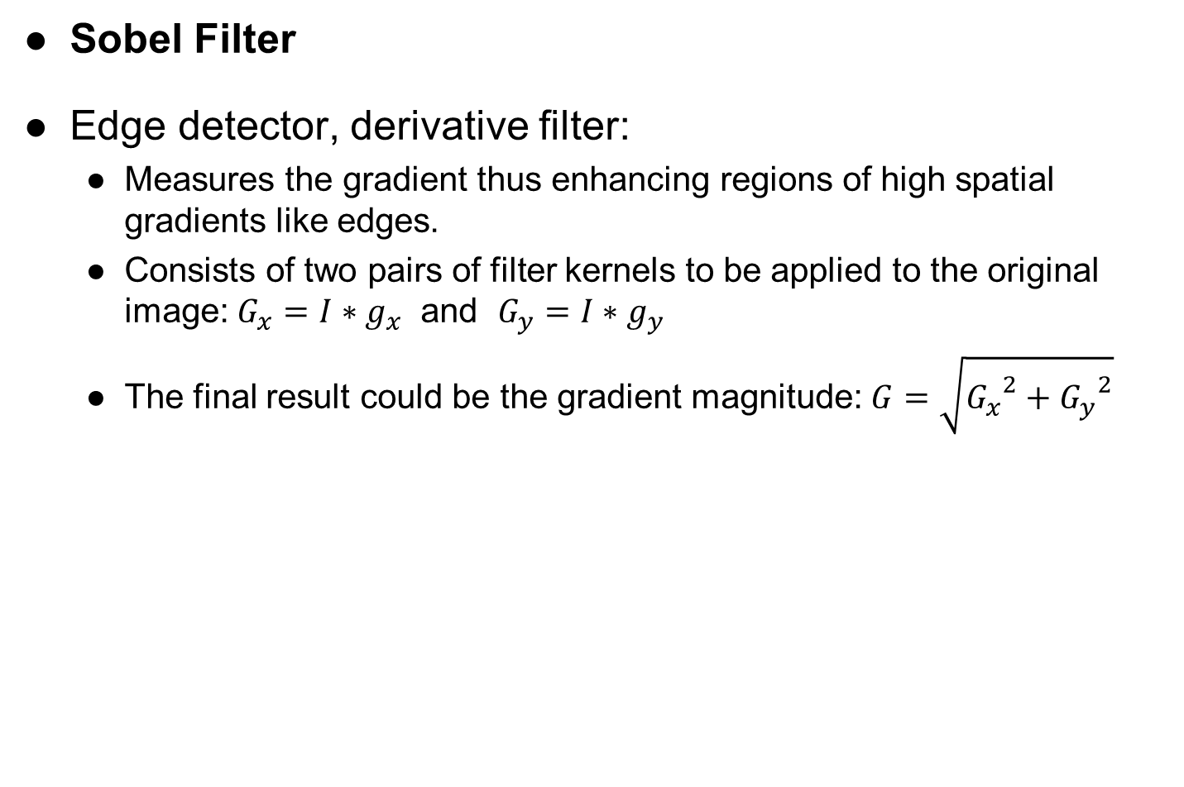
Sobel operator
Sobel Filter
Edge detector, derivative filter:
Measures the gradient thus enhancing regions of high spatial gradients like edges.
Consists of two pairs of filter kernels to be applied to the original image: $G_{x}=I∗g_{x}$ and $G_{y}=I∗g_{y}$
The final result could be the gradient magnitude: $G=\sqrt{{G_{x}}^{2}+{G_{y}}^{2}}$

Slide 34

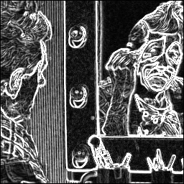
Notes:
Sobel example

Slide 35
Canny edge detector
Canny Edge Detector
Smooth the image using a Gauss filter
Suppresses noise
Filter the image using a derivative filter
Sobel Operator
Determine gradient vector ➔ partial derivatives in x and y direction
Find „important“ edges by thresholding the gradient magnitudes (keep all above threshold)
Trace along edges (orthogonal to the gradient) and suppress non-edge pixels

Slide 36

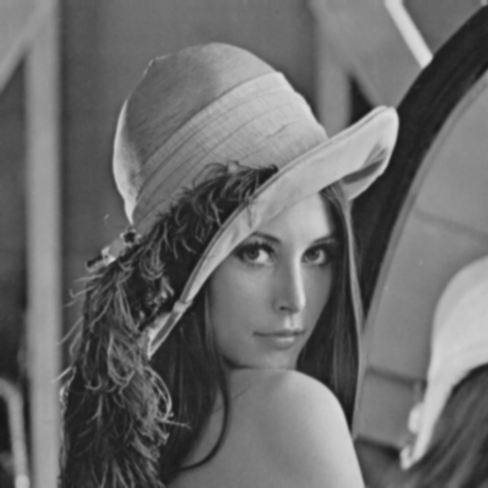
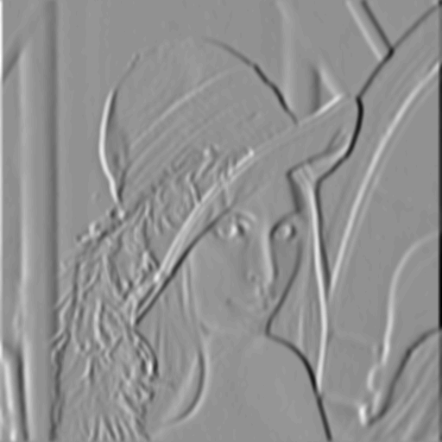
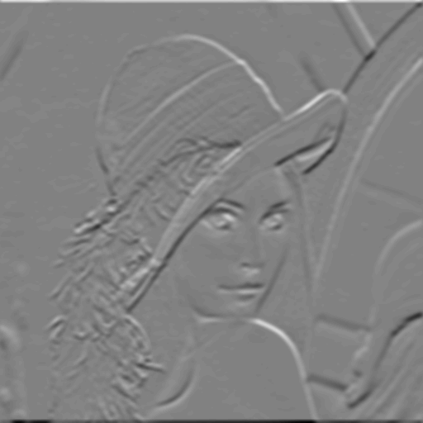
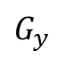

Canny edge detector
smoothed
vertical edges
horizontal edges
$$G_{x}$$
$$G_{y}$$

Slide 37




Canny edge detector
norm of the gradient
thresholding
thinning
$$G$$

Slide 38


Canny edge detector
Canny edge detector
σ=1 σ=2
Notes:
With Gaussian pre-smoothing of increasing width

Slide 39


Laplace of a Gaussian (LoG)
Laplace of a Gaussian
Laplace of a 2D signal :
“Deviation from average of neighbors”
Estimating derivatives by central differences yields:
Since second derivative measurements are very sensitive to noise, Gaussian smoothing is used in a first step

Slide 40

Function
1st derivative
2nd derivative
Notes:
Detect zero crossings (maxima/minima of first derivative)

Slide 41



LoG operator
Laplace of a Gaussian (LoG) Filter
LoG function and its discrete approximation

Slide 42


LoG (σ=1)
LoG (σ=1)
LoG zero crossings

Slide 43


LoG (σ=2)
LoG (σ=2)
LoG zero crossings

Slide 44
The Visualization Pipeline
simulation
data bases
sensors
data acquisition
raw data
filtering
vis data
The Visualization Pipeline
mapping
renderable representation
rendering
images, video
interaction

Slide 45
Mapping techniques
Mapping
Effectiveness of mapping techniques depends on input data, the problem, the display system, and the user
Examples:
Graphs, Bar Plots, Pie Plots…
Height Fields
Scatterplots
Parallel Coordinates
” Creation of renderable representations of the data to visualize“

Slide 46
Function Plots
Function Plots
Standard visualization of a “1D Scalar Field”:
Function plot
Points
1D manifold: line
f(s)
4
3
2
1
0
5
10
15
s

Slide 47

Height Fields
Height Fields
Function plot for a 2D scalar field
Points
2D manifold: surface
Surface representations
Wireframe
Hidden lines
Shaded surface

Slide 48

Wireframe representation
Draw each edge of the grid

Slide 49

Hidden line representation
Remove edges that belong to hidden faces
Better spatial orientation due to occlusion

Slide 50

Shaded surface
Requires specification of lighting/shading model

Slide 51




Isolines in 2D Scalar Fields
very important
Isolines in 2D Scalar Fields
Given a scalar function and a scalar value
Isoline consists of points
If f() is differentiable and ∇f ≠ 0, then isolines are curves
Alternative name: contour lines
Special kind of data condensation
Points on isolines often have similar semantics

Slide 53


Slide 54


Slide 55
Mapping: Visual Representations
Generation of isolines (contouring)
These methods can be classified in the following way:
Isolines on a regular grid
Pixel by pixel contouring
Contouring procedure
Grid free contouring

Slide 56
Mapping: Visual Representations
Pixel by pixel contouring
For each pixel, f(x, y) is computed.
If f(x, y) is within a tolerance of the isovalue, the pixel is part of the isoline.
good:
good image quality due to pixel-wise evaluation of function f.
different colors for different isovalues can easily be coded.
bad:
computationally intensive
missing of isoline
selection of isovalues influences quality of representation

Slide 57
Mapping: Visual Representations
2D contouring procedure
data grid is coarser than pixel grid
creating line segments by connecting intersection points of isolines and grid boundaries.
versions
grid sequence contouring
curve sequence contouring
Basic Marching Squares algorithm:
Input: data array and isovalue
Find all grid cells which are intersected by the isoline
Find intersection points of grid boundaries and isoline by interpolation
Draw isoline
very important

Slide 58




Which cells have an intersection with the isoline? (c is the isovalue)
Initially, mark all vertices with + or -, depending on the conditions:
For bi-linear interpolation inside a cell, an isoline passes only through cells with different signs at the four vertices, because:
Furthermore, the isoline can only intersect grid edges with different signs
+
+
+
+
+
+
+
+
+
+
–
+
+
–
–
–

Slide 59
Mapping: Visual Representations
Only 4 different cases of sign combinations
Symmetries: rotation, reflection, change + ↔ -
+/-
+/-
+/-
+/-
Notes:
Summarize the 4 cases of sign combinations on the black board:
all the same sign
one sign different
two signs different (on the same edge)
two signs different (on different edges; diagonally)

Slide 60

Isolines in a bi-linear grid cell are hyperbolas
However, the Marching Squares algorithm approximates them as straight lines

Slide 61
Mapping: Visual Representations
Compute intersections between isoline and cell edge
Use linear interpolation along the cell edges
+
-
+
+
-
-
+
+
+
+
+
+
-
-
-
-
-
-
+
+
+
+
+
+

Slide 62
Mapping: Visual Representations
Ambiguities
+
-
-
+
+
-
+
-
?
-
+
-
+
-
+
Solve ambiguity with decider:
Midpoint Decider (not exact)
Asymptotic Decider
-
+

Slide 63
Mapping: Visual Representations
Midpoint Decider (not exact)
Decide based on value at cell center via bilinear interpolation
+
-
+
-
+
+
-
-
+
-
+
?
+
-
+
-
-
+
-
-
+
-
+

Slide 64

Midpoint Decider (not exact)
Decide based on value at cell center via bilinear interpolation
+
-
-
+
Notes:
What is the value at the center?

Slide 65
Midpoint Decider (not exact)
Decide based on value at cell center
+
-
+
-
+

Slide 66




Shape of the Isolines?
Are isolines linear curves?
Isolines within a bi-linear cell are hyperbolas.

Slide 67
Bi-linear isolines: hyperbolas
asymptote
asymptote

Slide 68

The exact decider is the asymptotic decider.
It considers the bi-linear interpolant within a cell.
+
-
+
-
-
+

Slide 69

Consider bi-linear interpolation
Cell boundaries
Asymptote
Asymptote
Notes:
How to evaluate the asymptotic decider?

Slide 70






How to find the asymptote intersection?
Solve for :
Similar for :

Slide 71



Asymptotic Decider
-
a
+
if :
connect (a,b) and (c,d)
else:
connect (a,d) and (b,c)
b
d
+
-
c

Slide 72
Asymptotic decider: alternative way
Sort intersection points by their x or y coordinates
Connect (1,2) and (3,4)
y-axis
+
-
4
3
2
-
+
1
1
2
3
4
x-axis
Notes:
It is not possible for the isolines to cross the asymptotes.

Slide 73


c = 1.5

Slide 74

c = 5

Slide 75

c = 8.5

Slide 76

Marching Squares: Algorithm
Cell order approach for marching squares
Traverse all cells of the grid
Apply marching squares technique to each single cell
Disadvantage of cell order method
Every vertex (of the isoline) and every edge in the grid is processed twice
The output is just a collection of pieces of isolines which have to be post-processed to get (closed) polylines

Slide 77

Contour Tracing
Contour tracing approach
Start at a seed point of the isoline
Move to the neighboring cell into which the isoline enters
Trace isoline until
Bounds of the domain are reached or
Isoline is closed
Problem: How to find seed points efficiently?
In a preprocessing step, mark all cells which have a sign change
Remove marker from cells which are traversed during contour tracing (unless there are 4 intersection edges! )

Slide 78
Generating Smooth Isolines
Evaluate the gradient at vertices by central differences
Estimate tangents at the intersection points by linear interpolation (Note that the gradient is perpendicular to the isoline !)
Draw a parabolic arc which is tangential to the estimated tangents at the intersections
Cubic curve
Approximation with 2-3 subdivision steps is sufficient (corner cutting)
+
+
Cubic Curve
(Catmull Rom)
Quadratic Bézier curve
approximation with
subdivision
–
+

Slide 79
3D Volume Rendering
Direct VR
Slicing
Indirect VR
Ray-Casting
Slicing
Marching
Other
CPU
GPU
Ray-Guided GPU
View Aligned
Object/Axis Aligned
Cubes
Tetrahedra
Dividing Cubes
Contour Tracing

Slide 80
Strategies for 3D Volume Visualization
Slicing
Visualize 2D cuts through the volume
Direct volume rendering
Consider the data as a light-emitting medium with specific emission and absorption properties. The visual impression when looking at it is simulated according to the laws of physics
Indirect volume rendering techniques
Convert/reduce volume data to an intermediate representation (e.g., surface representation), which can be rendered with traditional techniques
80

Slide 81
Indirect Volume Rendering
Generic surface extraction techniques:
Choose an isovalue (arbitrarily or from segmentation)
Detect all cells the surface is passing through by checking the vertices
Mark vertices with respect to f(x,y,z) ≥/< (+/-) c
Consider all cells with different signs at vertices
Place graphical primitives in each marked cell and render the surface

Slide 82
Marching Cubes
very important
The Marching-Cubes (MC) algorithm
Invented by Lorensen & Cline 1987 Ambiguities fixed by Nielson & Hamann 1991
Works on the original data
Approximates the surface by a triangle mesh
Surface is found by linear interpolation along cell edges
Efficient computation by means of lookup tables
THE standard geometry-based isosurface extraction algorithm

Slide 83
The MC algorithm
Consider a cell
Classify each vertex as inside or outside
Build an index
Get per-cell triangulation from table[index]
Interpolate the edge location
Compute gradients (optional)
Consider ambiguous cases
Go to next cell

Slide 84
Marching Cubes: Step 1
Consider a cell defined by eight data values
(i,j+1,k+1)
(i+1,j+1,k+1)
(i,j,k+1)
(i+1,j,k+1)
(i,j+1,k)
(i+1,j+1,k)
(i,j,k)
(i+1,j,k)

Slide 85
Marching Cubes: Step 2
Classify each vertex according to whether it lies
outside the surface (value > isosurface value c)
inside the surface (value <= isosurface value c)
10
10
c=9
5
5
10
8
c=7
8
8
=inside
=outside

Slide 86
Marching Cubes: Step 3
Use the binary labeling of each voxel
to create an index
v8
v7
11110100
v4
v3
inside = 1
outside = 0
v5
v6
00110000
v1
v2
Index:
v1
v2
v3
v4
v5
v6
v7
v8

Slide 87
Marching Cubes: Step 4.1
typedef struct {
unsigned char nverts; /* # vertices above threshold */
unsigned char verts[8]; /* up to 8 vertices */
unsigned char nedges; /* # edges to be intersected */
unsigned char edges[12]; /* up to 12 edges */
unsigned char ntris; /* # triangles to be generated */
unsigned char tri_edges[15]; /* up to 5 triangles */
} lt;
static const lt LUT[256] =
{
/* 0 00000000 */ {
0, {0, 0, 0, 0, 0, 0, 0, 0},
0, {0, 0, 0, 0, 0, 0, 0, 0, 0, 0, 0, 0},
0, {0, 0, 0, 0, 0, 0, 0, 0, 0, 0, 0, 0, 0, 0, 0},
},
/* 1 00000001 */ {
1, {1, 0, 0, 0, 0, 0, 0, 0},
3, {1, 4, 9, 0, 0, 0, 0, 0, 0, 0, 0, 0},
1, {1, 4, 9, 0, 0, 0, 0, 0, 0, 0, 0, 0, 0, 0, 0},
},
/* 2 00000010 */ {
1, {2, 0, 0, 0, 0, 0, 0, 0},
3, {1,10, 2, 0, 0, 0, 0, 0, 0, 0, 0, 0},
1, {1,10, 2, 0, 0, 0, 0, 0, 0, 0, 0, 0, 0, 0, 0},
},
/* 3 00000011 */ {
2, {1, 2, 0, 0, 0, 0, 0, 0},
4, {2, 4, 9,10, 0, 0, 0, 0, 0, 0, 0, 0},
2, {2, 9,10, 2, 4, 9, 0, 0, 0, 0, 0, 0, 0, 0, 0},
},
index
lookup-table
intersected edges
resulting triangles

Slide 88

Marching Cubes: Step 4.1
For a given index, access an array storing a list of triangles and edges on which their vertices lie
All 256 cases can be derived from 15 base cases due to symmetries

Slide 89
Marching Cubes: Step 4.2
Get edge list from table
e7
Example for Index = 01110010 triangle 1 = e4, e7, e11 triangle 2 = e1, e7, e4 triangle 3 = e1, e6, e7 triangle 4 = e1, e10, e6
e11
e6
e4
e10
e1

Slide 90







Marching Cubes: Step 5
For each triangle edge, find the vertex location along the edge using linear interpolation of the voxel values

Slide 91


Marching Cubes: Step 6
Calculate the normal at each cube vertex
Use linear interpolation to compute the polygon vertex normal (of the isosurface)

Slide 92
Marching Cubes: Step 7
Consider ambiguous cases
Solve ambiguities using asymptotic decider similar to marching squares

Slide 93
Marching Cubes: Step 7
Consider ambiguous cases
Ambiguous cases: 3, 6, 7, 10, 12, 13
Adjacent vertices: different states
Diagonal vertices: same state
Resolution: decide for one case
or
or

Slide 94
Marching Cubes: Step 7 cont.
Step 7 cont.: Consider ambiguous cases
Asymptotic Decider [Nielson, Hamann 1991]
Assume bilinear interpolation within a face
Hence isosurface is a hyperbola
Compute the point p where the asymptotes meet
Sign of S(p) decides the connectivity
asymptotes
p
hyperbolas

Slide 95

Marching Cubes: Summary
Marching Cubes: Summary
256 Cases
Reduces to 15 cases by symmetry
Ambiguity resides in cases 3, 6, 7, 10, 12, 13
Causes holes if arbitrary choices are made
Up to 5 triangles per cube
Dataset of 512³ voxels can result in several million triangles -> many Mbytes!
Optimization:
Prevent vertex replication
Mesh simplification

Slide 96
Contour Propagation
Acceleration of cell traversal
Algorithm:
Trace isosurface starting at a seed cell
Breadth-first traversal along adjacent faces
Finally, cycles are removed, based on marks at already traversed cells
Similar to 2D approach
Same problem:
Find ALL disconnected isosurfaces
Issue of optimal seed set

Slide 97
Preventing Vertex Replication
Based on a unique representation of edges shared by multiple voxels
Requires a „ghost“ layer of voxels along each axis
12
10
11
9
8
5
7
6
3
4
2
2
3
1
1
All edges (12)
Unique edges (3)

Slide 98




Examples
Isosurface at different time steps
Isosurface in 3D medical data set

Slide 99




Examples
3 Isosurfaces
Isosurface of a sphere in a low resolution grid
2 Isosurfaces

Slide 100


Marching Tetrahedra
Marching Tetrahedra [Shirley et al. 1990]
Primarily used for unstructured grids
Split cells into tetrahedra
Process each tetrahedron similarly to the MC-algorithm

Slide 101

Marching Tetrahedra
Two different surface types:
one „–“ and three „+“ (or vice versa) The surface is defined by one triangle
two „–“ and two „+“ Sectional surface given by a quadrilateral – split it into two triangles using the shorter diagonal

Slide 102

Cube to Tetrahedra Howto
Initial Cube
Five Tetrahedral
Initial Cube
Two Prisms
Six Tetrahedra

Slide 103

Properties of Marching Tetrahedra
Fewer cases (3 instead of 15)
no problems with consistency between adjacent cells
Number of generated triangles might increase considerably compared to the MC-algorithm when splitting voxels into tetrahedra
Huge amount of geometric primitives

Slide 104
Octree-Based Isosurface Extraction
Acceleration of MC by domain search
Octree-based approach [Wilhelms, van Gelder 1992]
Spatial hierarchy on a grid (tree)
Store minimum and maximum scalar values for all children with each node
While traversing the octree, skip parts of the tree which cannot contain the specified isovalue

Slide 105
Filtering and Mapping
Summary
Data Filtering
Data reduction (selection)
Noise reduction, feature enhancement
Data Mapping: Indirect Volume Rendering
Marching Squares 2D isoline extraction (ambiguity decider)
Marching Cubes 3D isosurface extraction
Marching Tetrahedra

